Slide 1
Build-a-Bot Workshop
Creators: Sue Lim, Ralf Schmälzle
Title suggestions by: ChatGPT

Slide 2
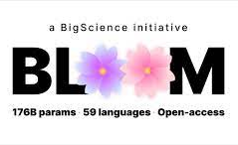
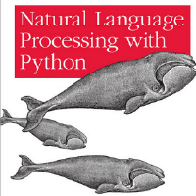
Overview
Part I: Background
Lecture 1 : Word embedding, word2vec
Mini-exercise: Generate hot embedding for words
Lecture 2: Next-word prediction, sequence modeling
Lecture 3: Prompting, language models
Mini-exercise: Download Bloom, generate message on Bloom
Part II: Let’s Build a Health Bot!
Lecture 4: What is reinforcement learning?
Main activity:
Get into pairs and pick a health topic
Download chatbot jupyter notebook template
(10 minutes) Update code to cater to health topic
(5 minutes) Test chatbot with another pair
Continue steps 3 & 4 as many times as needed
Showcase the chatbot in front of the class
https://bigscience.huggingface.co/blog/bloom
Bird, Steven, Edward Loper and Ewan Klein (2009), Natural Language Processing with Python. O’Reilly Media Inc

Slide 3
Background

Slide 4

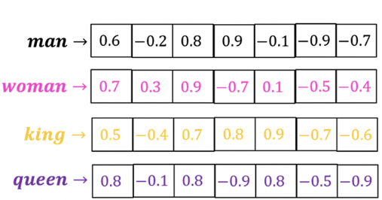
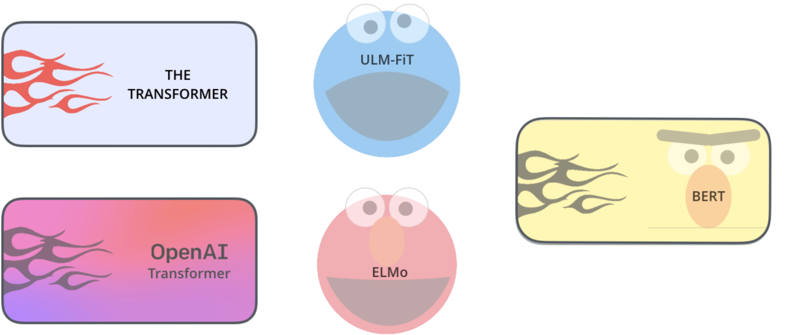
Word Embeddings
Large corpus of documents
Example of what vectors may look like:
Words converted to vectors (word embeddings)
Language models
Notes:
Resources:
https://medium.com/@hari4om/word-embedding-d816f643140
https://jalammar.github.io/

Slide 5
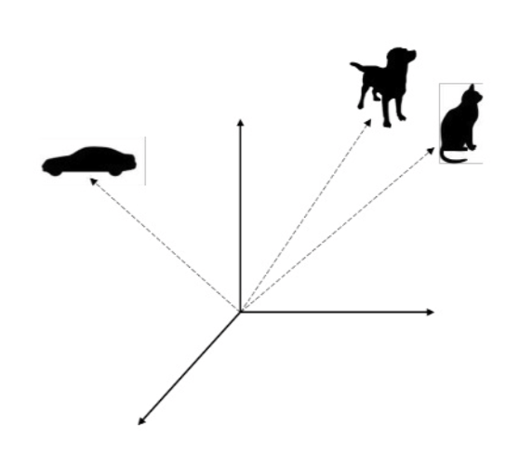
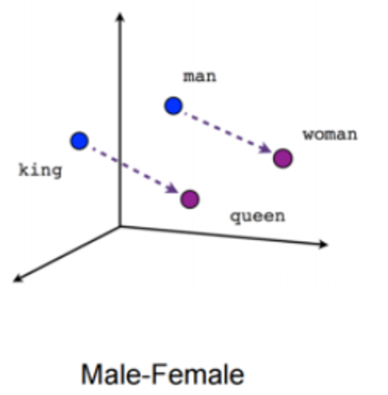
Word2Vec: Capturing Meaning Mathematically
Visualization: https://projector.tensorflow.org
Notes:
Machines cannot understand words. Thus, words need to be converted into numbers and this is where word embeddings come in. Word embedding refers to representing words as a numeric vector based on meaning. When mapped, words with similar meanings will be closer together. – show protector.tensorflow as an example.
Sources:
https://jalammar.github.io/illustrated-word2vec/

Slide 6
Mini-Activity 1: Generate Word Embeddings
Template:
Example:
 | Dim. 1 | Dim. 2 | Dim. 3 | Dim. 4
Word 1 | -1 to 1 | -1 to 1 | -1 to 1 | -1 to 1
Word 2 | -1 to 1 | -1 to 1 | -1 to 1 | -1 to 1
Word 3 | -1 to 1 | -1 to 1 | -1 to 1 | -1 to 1
Word 4 | -1 to 1 | -1 to 1 | -1 to 1 | -1 to 1
 | Animal | Person | Young | Small
Dog | 0.9 | -0.9 | -0.4 | 0.1
Kitten | 0.9 | -0.9 | 0.6 | 0.8
Boy | -0.4 | 0.8 | 0.7 | 0.6
Woman | -0.3 | 0.9 | -0.1 | -0.2
Instructions: Pick 4 words and 4 possible meaning dimensions for the words. Then fill in the estimated values between -1 (furthest from dimension) and 1 (closest to the dimension). See the table to the right as an example.
Notes:
Resource:
https://medium.com/intelligentmachines/word-embedding-and-one-hot-encoding-ad17b4bbe111

Slide 7
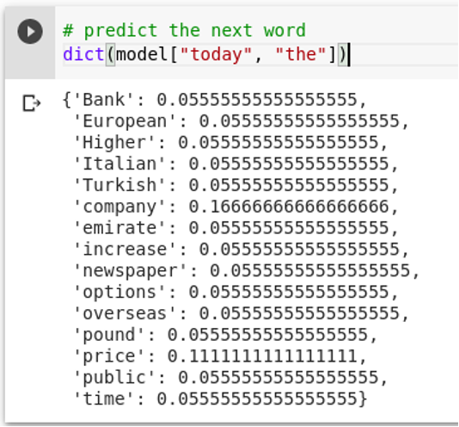
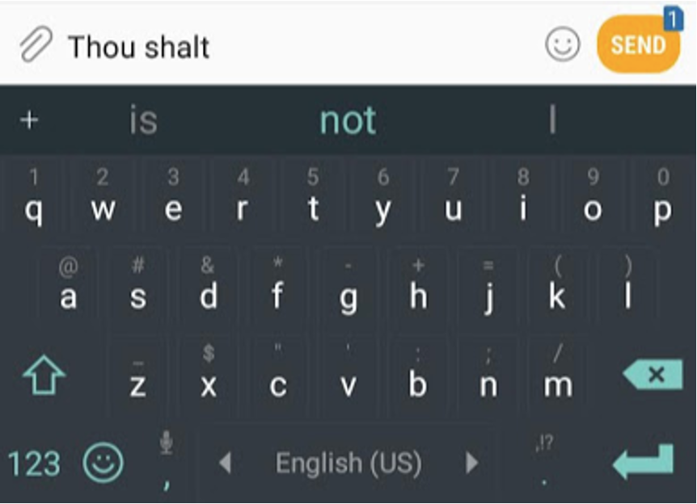
Next-Word Prediction
Notes:
Resource:
https://jalammar.github.io/illustrated-gpt2/

Slide 8
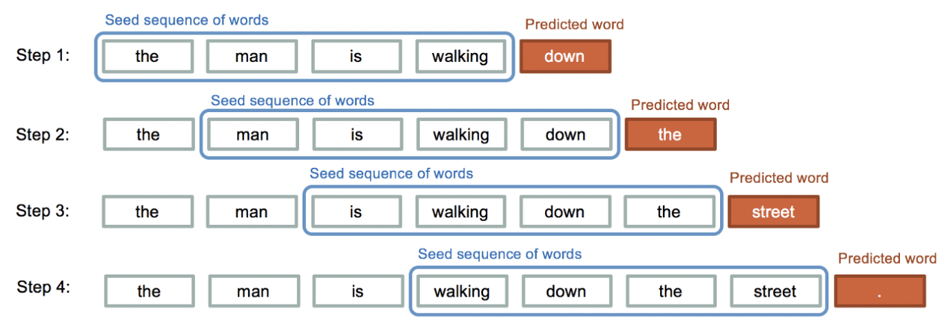
Sequence Modeling
Q: How does the trained model generate an entire sentence(s)?
A: By calculating the probability of the next word, given the previous sequence of words, over and over again.
This process is important because sentences are ordered sequence of words
Notes:
Resource:
https://medium.com/@david.campion/text-generation-using-bidirectional-lstm-and-doc2vec-models-1-3-8979eb65cb3a

Slide 9
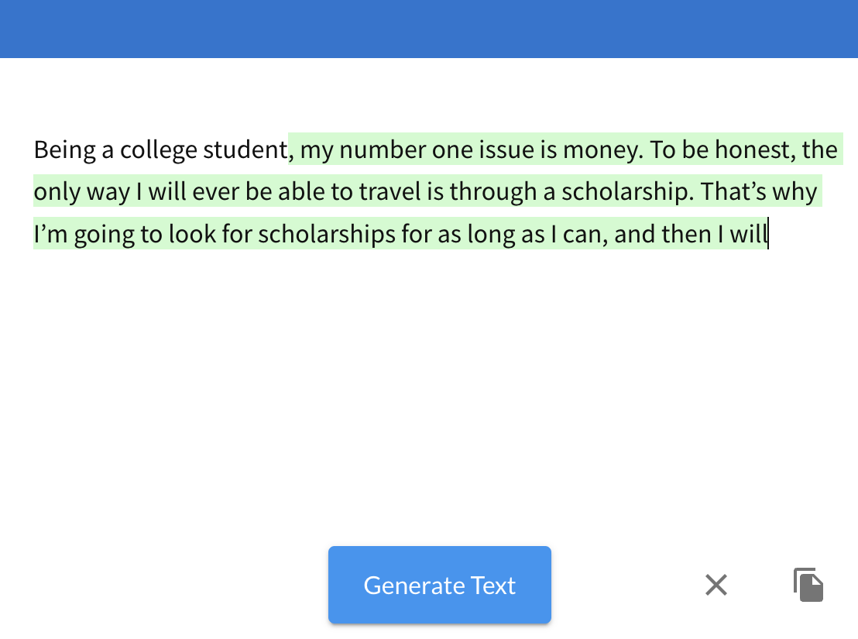
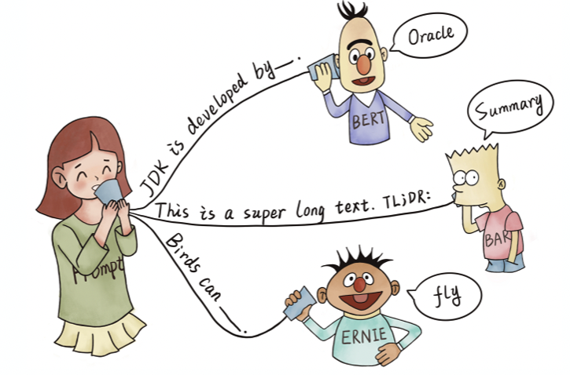
Prompting: Getting the language model started
https://app.inferkit.com/demo
Image from: Liu, P., Yuan, W., Fu, J., Jiang, Z., Hayashi, H., & Neubig, G. (2023). Pre-train, prompt, and predict: A systematic survey of prompting methods in natural language processing. ACM Computing Surveys, 55(9), 1-35. https://doi.org/10.1145/3560815
Notes:
Resources:
https://www.linkedin.com/pulse/introduction-llm-prompt-engineering-stephen-redmond

Slide 10
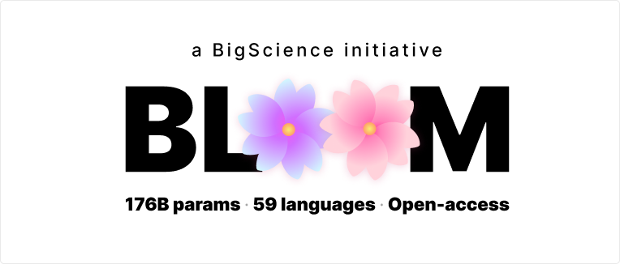
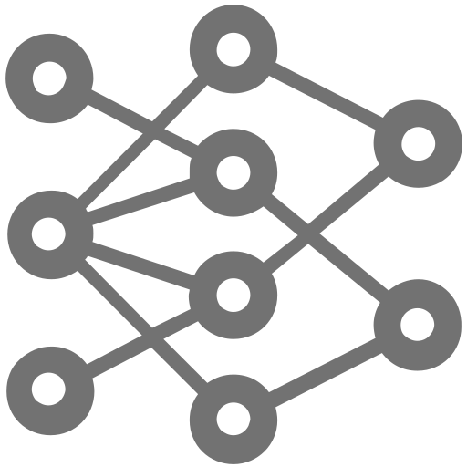
Language Models: Example of Message Generation
Prompt Engineering
Generated Message
1: Did you know, #Folicacid
1: Did you know, #Folicacid helps prevent neural tube defects, birth defects, and bone fractures?
2: Folic acid during pregnancy
2: Folic acid during pregnancy may have a protective effect against neural tube defects and birth defects.
7B1 parameters
60 tokens
top_k = 40
top_p = 0.9
temperature = 0.7
3: It's National Folic Acid Awareness week and the good news is that folic acid is not only good for pregnant women, but it is also good for us all.
3: It’s National Folic Acid Awareness week
4: Every woman needs #folicacid every day, even if she doesn't think she is at risk of getting pregnant. It helps prevent birth defects.
4: Every woman needs #folicacid every day
From: Lim, S., & Schmälzle, R. (2023). Artificial Intelligence for Health Message Generation: An Empirical Study Using a Large Language Model (LLM) and Prompt Engineering. Frontiers in Communication, 8. https://doi.org/10.3389/fcomm.2023.1129082
Notes:
Resources:
Official citation of Bloom model
Scao, T. L., Fan, A., Akiki, C., Pavlick, E., Ilić, S., Hesslow, D., ... & Manica, M. (2022). Bloom: A 176b-parameter open-access multilingual language model. arXiv preprint arXiv:2211.05100.

Slide 11
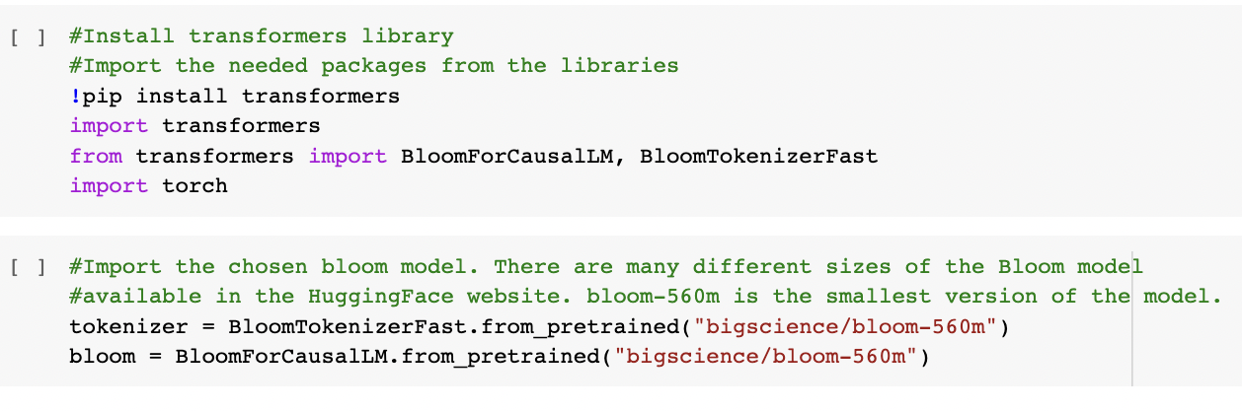
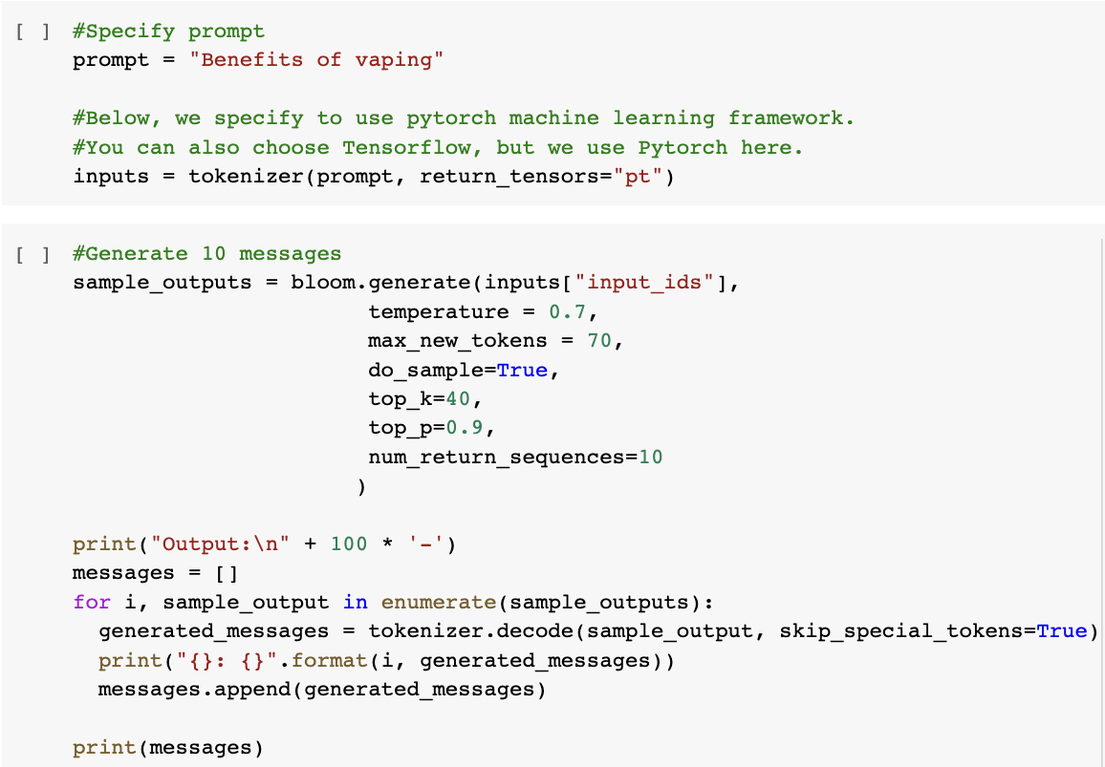
AI-Message Generation Activity
Open jupyter notebook template in Google Colab
Come up with 3-5 prompts on any topic
Multiple topics are encouraged
Run 10 messages for each prompt
Can explore adjusting parameters
After 10-15 minutes, discuss as a class:
Where can this type of technology be used?
Do you see applications for health communication?
Did you notice any problems?

Slide 12
Let’s Build a Health Bot!

Slide 13


What is Reinforcement Learning?
How an agent (person or machines) masters the connection between a situation and action based on the maximization of reward and minimization of punishments (Palminteri & Pessiglione, 2013)
Feedback to Chatbot
Human Evaluators
Chatbot
AI-Generated Message
Notes:
Resources:
https://towardsdatascience.com/reinforcement-learning-101-e24b50e1d292
https://huggingface.co/docs/trl/index
Li, W., Luo, H., Lin, Z., Zhang, C., Lu, Z., & Ye, D. (2023). A Survey on Transformers in Reinforcement Learning. arXiv preprint arXiv:2301.03044.

